Slide 1

Programming Platforms and Paradigms

Slide 2
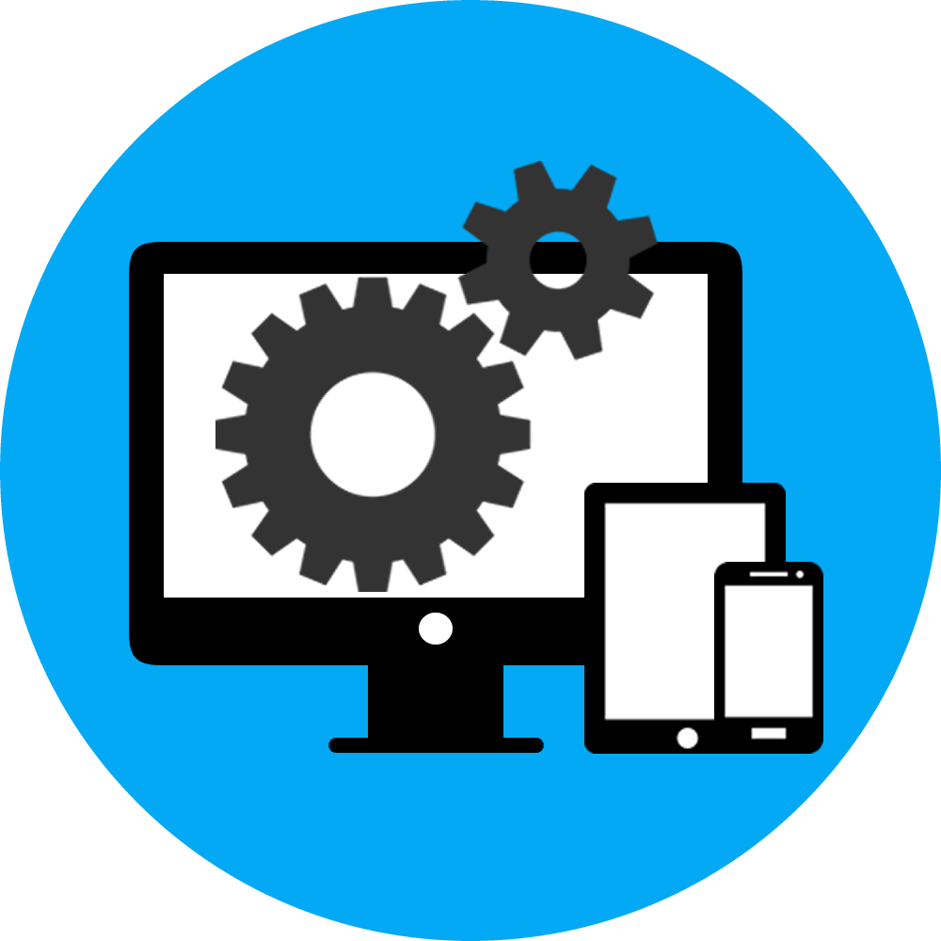
What is Software?
Wikipedia - “Computer software, or simply software, is a collection of data or computer instructions that tell the computer how to work”

Slide 3
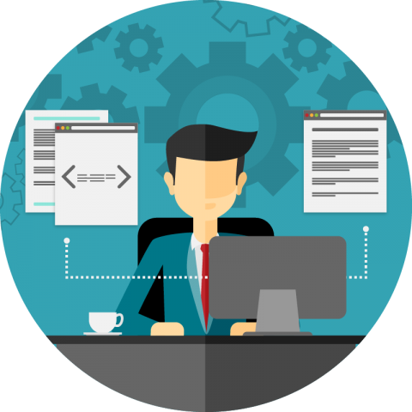
Who is the developer?
Technopedia - “A developer is an individual that builds and create software and applications. He or she writes, debugs and executes the source code of a software application.”

Slide 4

Software Platforms
Desktop - Windows, Linux, IBM, macOS, Solaris, …
Mobile - Android, iOS, BlackBerry, Symbian, Windows Phone, ...

Slide 5
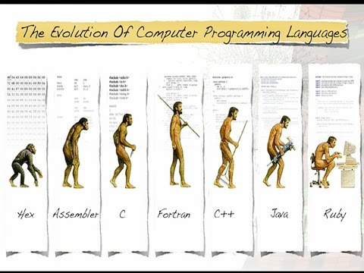
Evolution of Languages

Slide 6
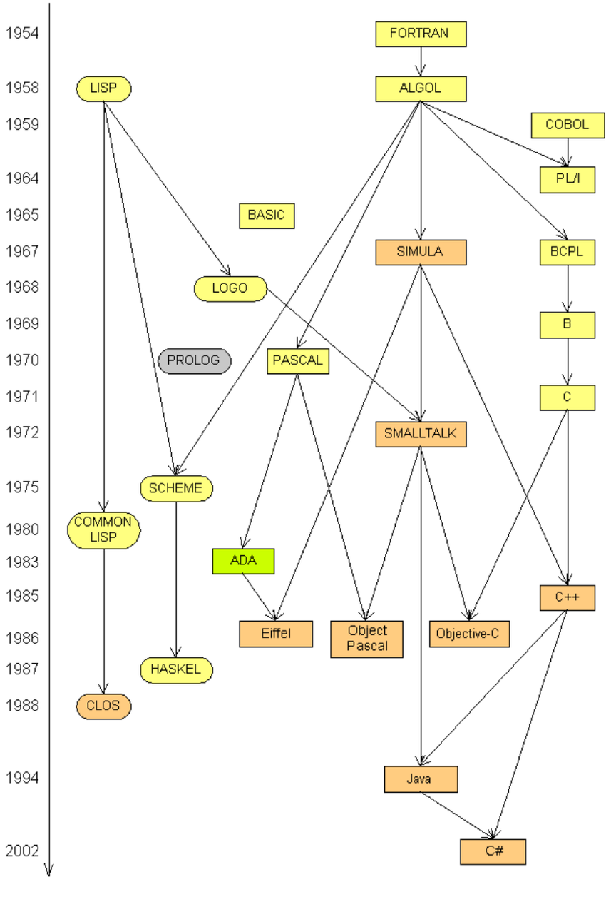
Evolution of Languages

Slide 7
Programming Language Paradigm
Imperative in which the programmer instructs the machine how to change its state,
Procedural which groups instructions into procedures,
Object-oriented which groups instructions together with the part of the state they operate on,
Declarative in which the programmer merely declares properties of the desired result, but not how to compute it
Functional in which the desired result is declared as the value of a series of function applications,
Logic in which the desired result is declared as the answer to a question about a system of facts and rules,
Mathematical in which the desired result is declared as the solution of an optimization problem

Slide 8
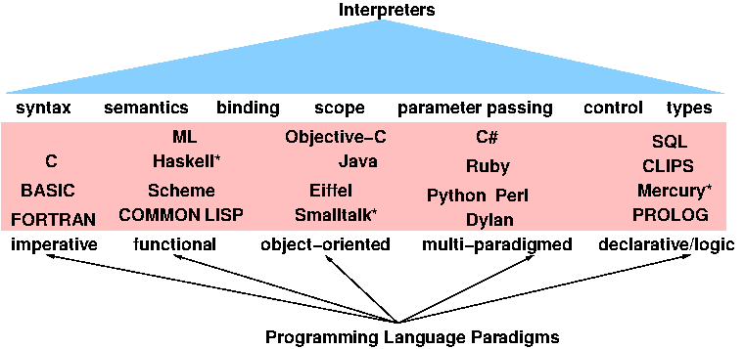
Programming Language Paradigm
Notes:
By Our Audience we mean: describe the typical demographics in the classrooms like we have everyone from age 15 till 40+, boys and girls, working and students, etc. THis program is designed for everyone

Slide 9
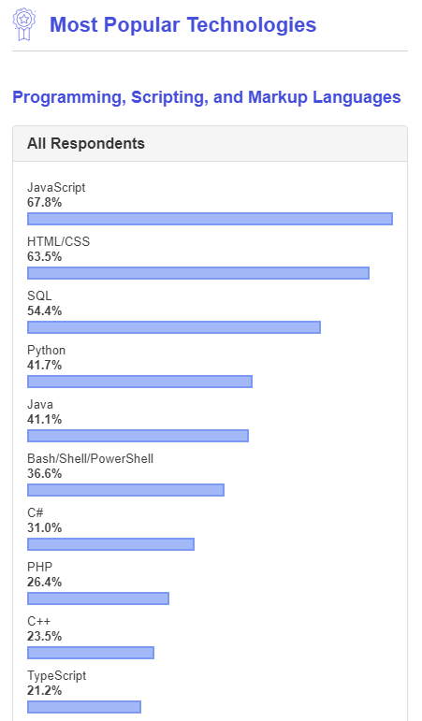
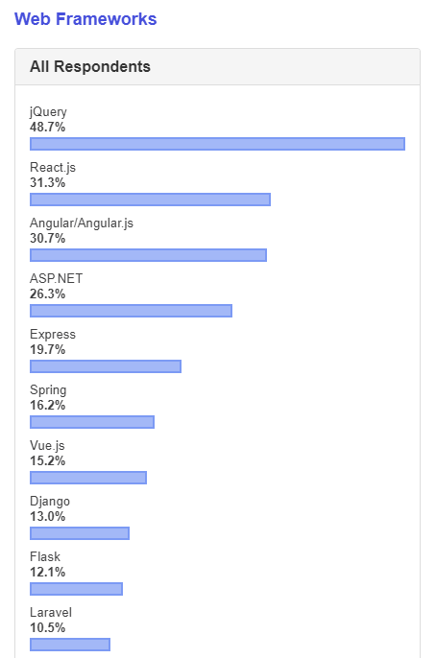
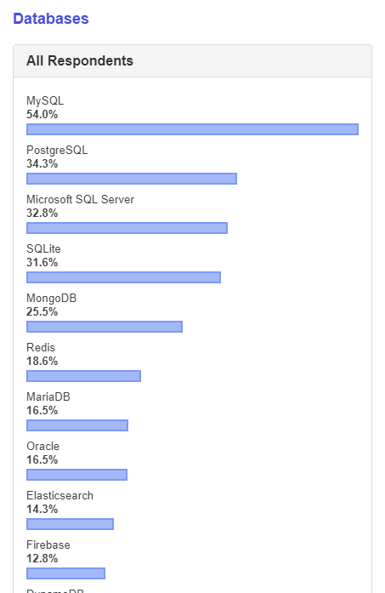
Most Populars - Stackoverflow
https://insights.stackoverflow.com/survey/2019

Slide 10
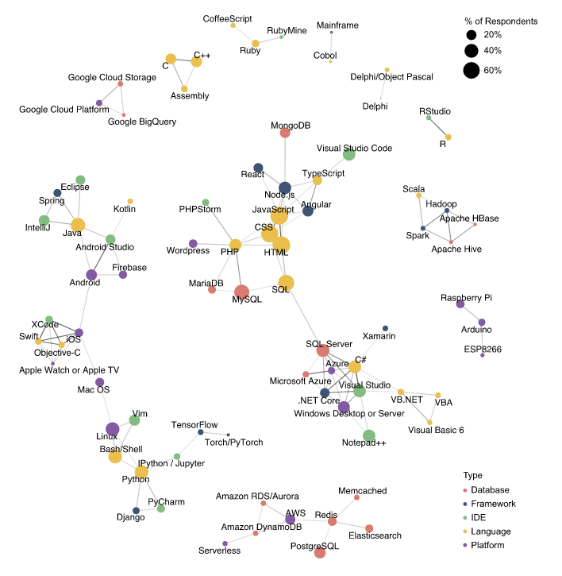
How Technologies
Are Connected

Slide 11
Homework
Research about Programming Languages (Assembly, C, JavaScript, C#)
Hansi Paradigmalara uygundur
Hansi Sahelerde isitifade olunur
Ustunlukleri
Zeiflikleri
Check out https://insights.stackoverflow.com/survey/2019#technology

